Slide 1
Streaming SQL : Patterns
Pravin Y Pawar

Slide 2
Streaming SQL : Patterns
Streaming extends the SQL model (a.k.a. relational model) by adding time into the event and accepting that each data point occurs at a specific point of time
From that point, it is natural to think about the order of events
The most natural problem is asking, “Is Event A followed by Event B?”
For example
Assume that we want to detect if the temperature changed more than 20% within five minutes
Need to track the temperatures for the last five minutes and match them against each new event
Reference : https://wso2.com/library/articles/2018/02/stream-processing-101-from-sql-to-streaming-sql-in-ten-minutes/

Slide 3
Streaming SQL : Patterns(2)
Use cases
The “happens after” relationship is a key component
Detect the rise or fall of a value
Detect a peak or a trough
Detect chart patterns (i.e. for stock markets)
Check for the completeness of a task (Does the reply to an email come within an hour?)

Slide 4
Streaming SQL : Patterns(3)
No Patterns in SQL
Although simple and widely used, it is very complicated to detect a “happens after” pattern with SQL
The only way to do that is to attempt to join a table (or stream against itself), which is very expensive and complicated if you try to detect multiple “happens after” relationships
Why it wasn't a concern with basic SQL?
Two main reasons
First, time was not an integral part of the SQL model, hence patterns was not often considered
Second, it was very hard to implement with the SQL model, hence no one wanted to do it.

Slide 5
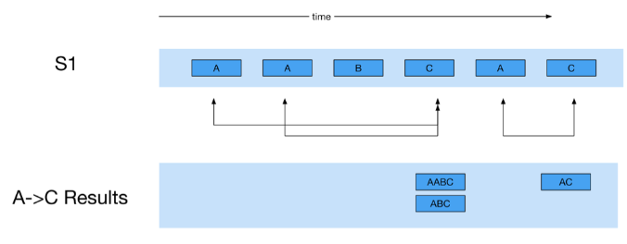
Streaming SQL : Patterns(4)
Pattern Operator
For Example,
“->” symbol represents the "happened after" relationship
It will track each event pair to see whether “event A is followed by C” happens and trigger an output when it happens
For example, in above case, it triggers “AABC”, “ABC”, and “AC” as those are the cases where “event A is followed by C” occurs

Slide 6
Streaming SQL : Patterns(5)
“happens after" relationship
Case 1: A single pattern query can include multiple “happens after relationship” instances.
A->B->C
Case 2: Also each element in the query can be annotated with “optional” and any number of annotations such as regular expressions. For example:
A->B?->C means A optionally followed by B and then C
A->B*->C means A followed by any number of Bs and then C

Slide 7
Thank You!
In our next session: Streaming Machine Learning

